Slide 1

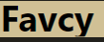
Favcy - Builder X | Idea To Grants
Startup Analyst – Subham Choudhary

Slide 2

Introduction to BuilderX (Launch Your Startup in 12 Weeks)
Statistics
32+ Ventures Built
10K+ Hours of Brainstorming
₹4 Crores+ Funds Raised
3K+ Angel Investor Network
BuilderX is designed to help early-stage founders launch their startups quickly and successfully.
Provides equity-free grants and personalized support.

Slide 3

Addressing Key Startup Challenges (Why 90% Startups Fail )
Lack of Problem Statement
35% fail due to not addressing market needs.
Lack of Capital
Only 9% of startups get funded.
8% fail due to poor product.
Common issues with fund-raising approaches.
Lack of Personalized Support
Generic advice doesn't work; need for tailored guidance.
Network accelerates growth.
Lack of Right Network
First-time founders often lack access to mentors, customers, and investors.

Slide 4
BuilderX Solutions (How BuilderX Helps )
Equity-Free Grants
Grants up to ₹50 Lakhs to give your idea a fair chance.
Right Problem Statement & Proof of Concept
Increase success chances by validating market needs.
Structured & Personalized Support
Unique Roadmap & Project Plan to eliminate wastage.
Network Access
Community of 2K+ founders & 3K+ investors.
Actionable Roadmap with 250+ tasks from idea to market.
1-1 Mentorship Sessions with serial entrepreneurs.
Pitch Perfect Day for feedback from seasoned investors.

Slide 5
Success Stories & Program Details
Program Timeline
Weeks 1-4: Foundation & Customer Interaction
Resources Provided
$60K Startup Toolbox: AWS credits, Zoho, GitHub, Hubspot, Notion.
Weeks 5-8: POC & Investor Feedback
Weeks 9-12: MVP & Grant Application
100+ Domain Experts for guidance in various areas.
Market access and successful launch strategies.
Success Stories
TellerSpot: From idea to sale within 12 months.
AuzaarPay: Raised 30 lakh in grants, 200+ active customers.
SpruceShine: Operating in 4 locations within a year.
PayTamasha: Secured 30 lakh in grants, movies showcased in top film festivals.

Slide 6

Startup Analysis
Startup Analyst = Subham Choudhary

Slide 7

1. Founder Name: Amit Kumar
Business Idea: ROZZANA, a retail kirana store chain
Stage: Seed Funding
Ability to Pay: Low
Strengths
Unique pricing model (minimum 10% cheaper)
Weaknesses
High initial capital requirement
Extensive store network (maximum 5-minute walking distance)
Wide product range (everything under one roof)
Technology integration for efficient operations and customer experience
Needs significant marketing and user acquisition

Slide 8

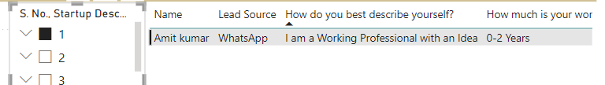
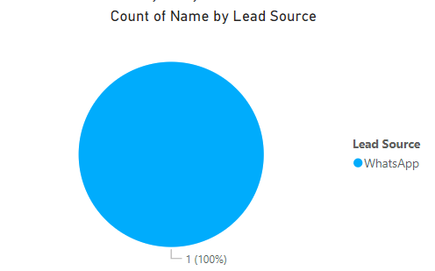
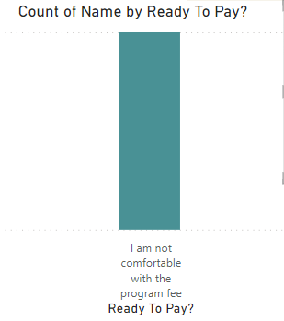
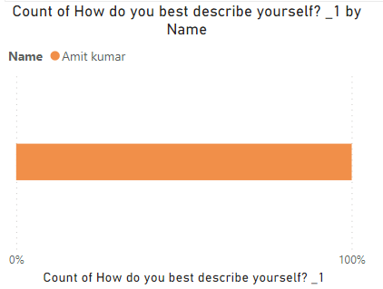
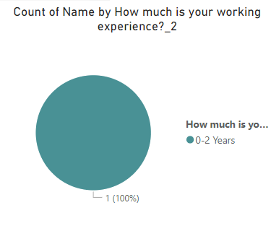
Visual Representation

Slide 9
2. Founder Name: Sanyam Arora
Business Idea: Lugzry, a circular sustainable fashion marketplace
Stage: Validation
Ability to Pay: Low
Strengths
Zero waste model
Weaknesses
Needs more marketing and user acquisition
Helps clothing brands with EPR compliance
Positive initial feedback from brands
Requires strong partnerships with recycling factories

Slide 10

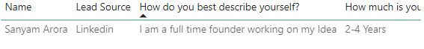
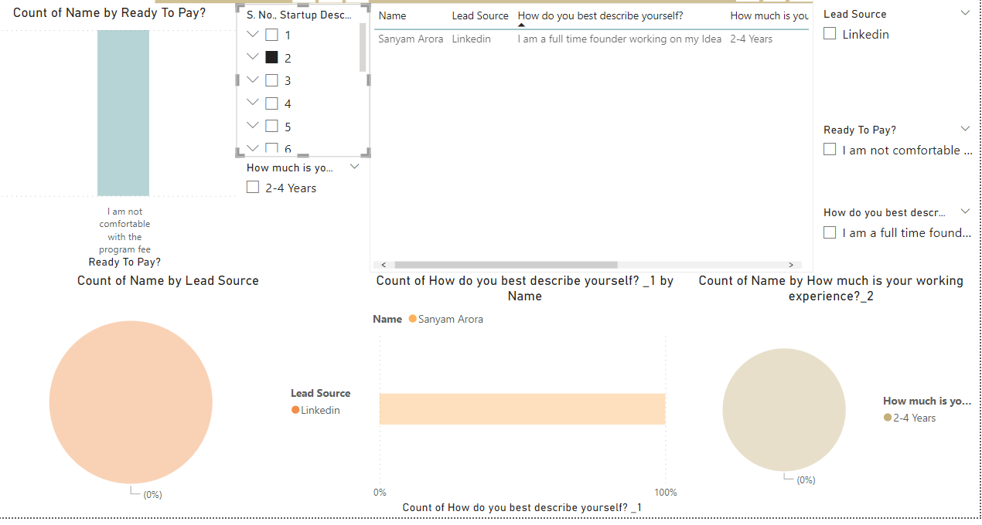
Visual Representation

Slide 11
3. Founder Name: Chatterjee
Business Idea: HR tech platform for campus placement in lesser-known colleges
Stage: Validation
Ability to Pay: Low
Strengths
Addresses a niche market with high potential
Weaknesses
Needs significant user acquisition and partnerships with colleges
Strong demand for employability solutions
High competition in the HR tech space

Slide 12

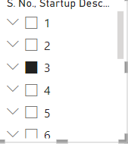
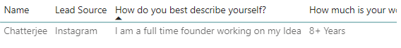
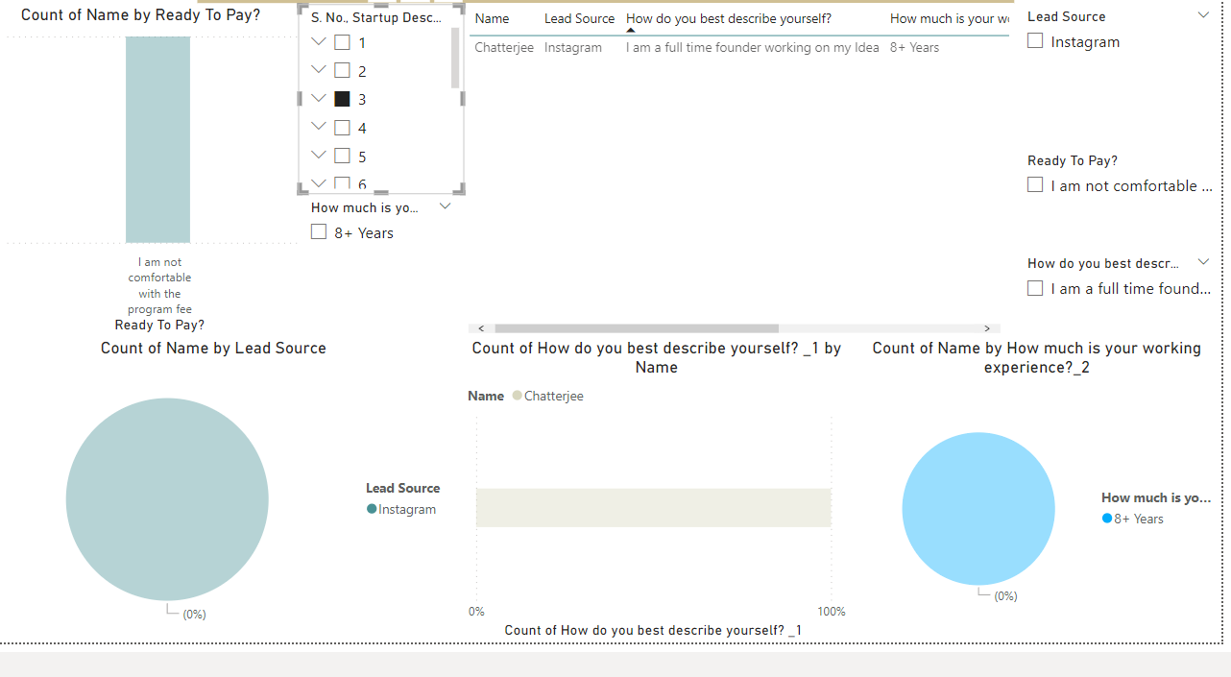
Visual Representation

Slide 13
4. Founder Name: Aakash Kumar
Business Idea: E-commerce platform
Stage: Validation
Ability to Pay: High
Strengths
High market potential
Weaknesses
Needs more marketing and user acquisition
Positive initial user feedback
High competition in the e-commerce space

Slide 14
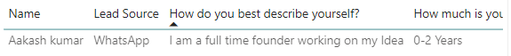
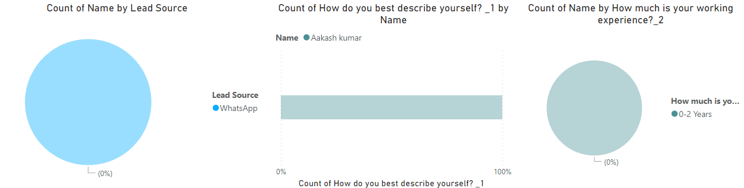
Visual Representation

Slide 15
5. Founder Name: Mahabaleshwar R Bhat
Business Idea: Agnihotri Aerospace, advanced systems for reusable rockets and missiles
Stage: Seed Funding
Ability to Pay: Low
Strengths
Cutting-edge technology
Weaknesses
High initial capital requirement
High market potential in aerospace
Needs significant marketing and user acquisition

Slide 16

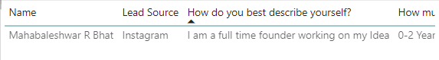
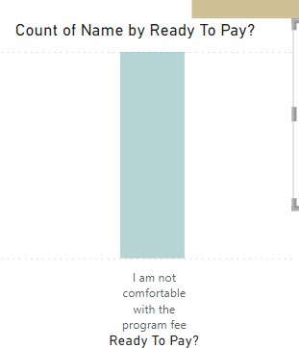
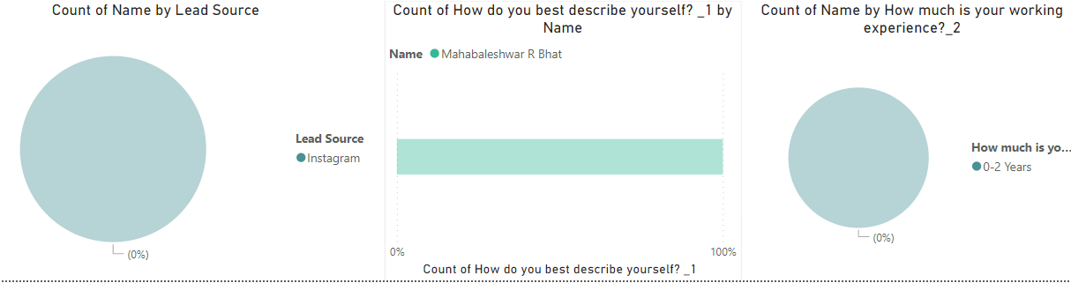
Visual Representation

Slide 17
6. Founder Name: Syed Laheeq
Business Idea: Offline and online meat stores
Stage: Validation
Ability to Pay: Low
Strengths
Diverse product range (chicken, fish, mutton, marinates)
Weaknesses
Cold chain logistics complexities
Positive initial user feedback
Regulatory compliance for food safety

Slide 18

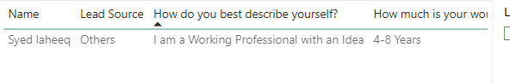
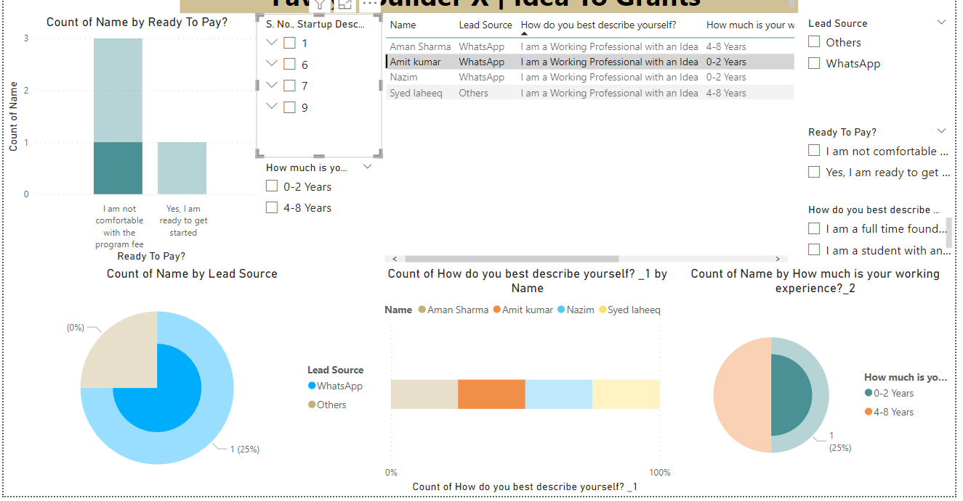
Visual Representation

Slide 19
7. Founder Name: Aman Sharma
Business Idea: Benefits platform for freelancers with micro-financing opportunities
Stage: Validation
Ability to Pay: Low
Strengths
Addresses a niche market with high potential
Weaknesses
Trust-building with freelancers
Provides financial security for freelancers
Innovative micro-financing solutions
Financial risk management

Slide 20

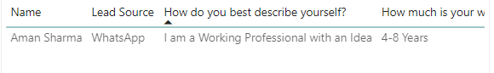
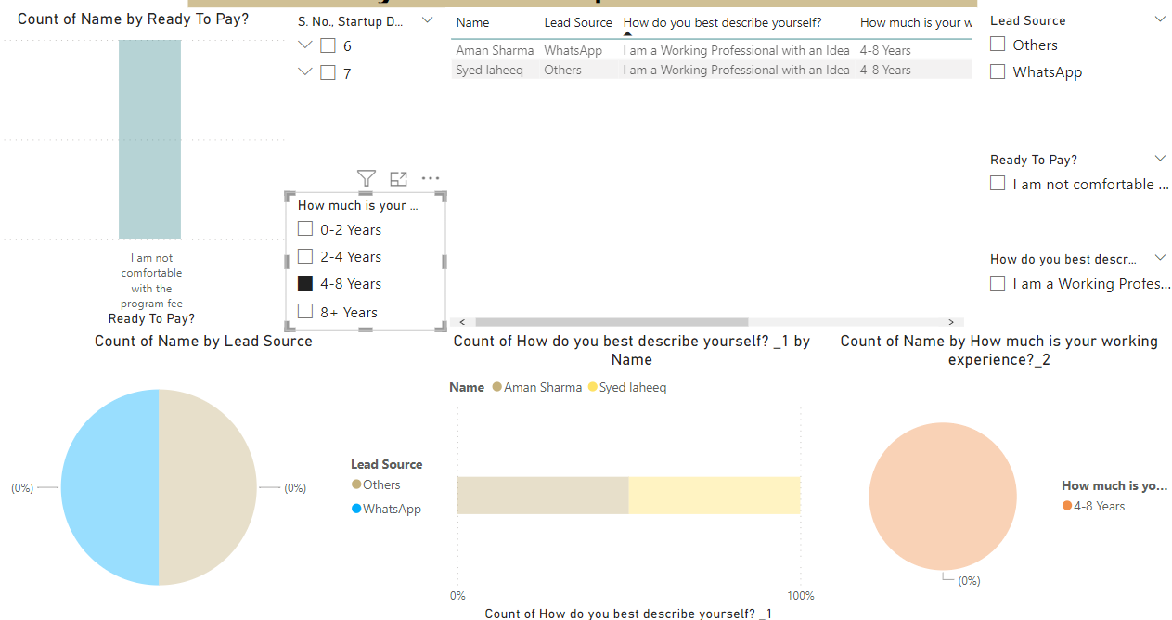
Visual Representation

Slide 21
8. Founder Name: Athul C Nambiar
Business Idea: My Home, a manpower-handling platform
Stage: Validation
Ability to Pay: High
Strengths
Addresses a niche market with high potential
Weaknesses
Workforce reliability issues
Positive initial user feedback
Efficient manpower management solutions
High competition in the manpower handling space

Slide 22

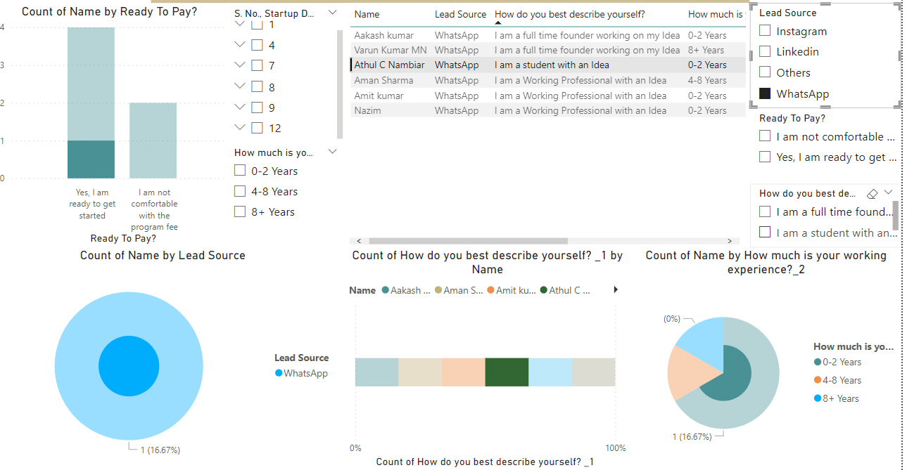
Visual Representation

Slide 23
9. Founder Name: Nazim
Business Idea: An offline and online meat store
Stage: Validation
Ability to Pay: High
Strengths
Diverse product range (chicken, fish, mutton, marinates)
Weaknesses
Customer retention challenges
Positive initial user feedback
Strong supply chain management
Stringent food safety regulations

Slide 24

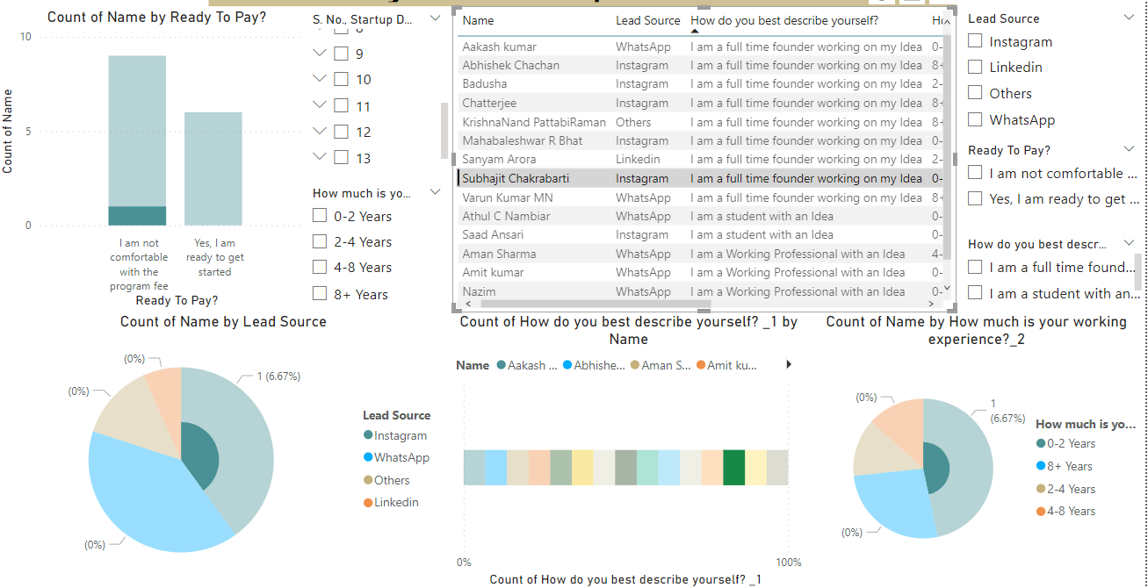
Visual Representation

Slide 25
10. Founder Name: Subhajit Chakrabarti
Business Idea: Healthy pure, extra virgin, cold-pressed, unprocessed & unrefined cooking oil brand
Stage: Validation
Ability to Pay: Low
Strengths
Unique hero product (Avocado oil)
Weaknesses
Limited market awareness
Positive initial user feedback
Health-focused product positioning
Price sensitivity among consumers

Slide 26

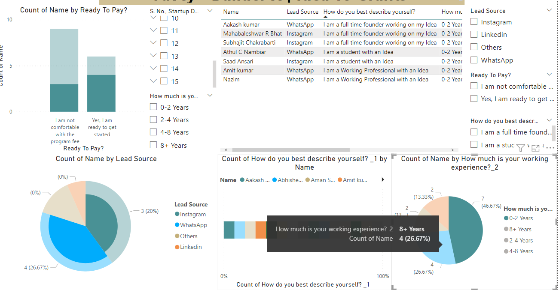
Visual Representation

Slide 27
11. Founder Name: Badusha
Business Idea: Financial confidence platform
Stage: Validation
Ability to Pay: Low
Strengths
Addresses a niche market with high potential
Weaknesses
User trust and adoption challenges
Positive initial user feedback
Comprehensive financial planning tools
High competition in the financial confidence space

Slide 28

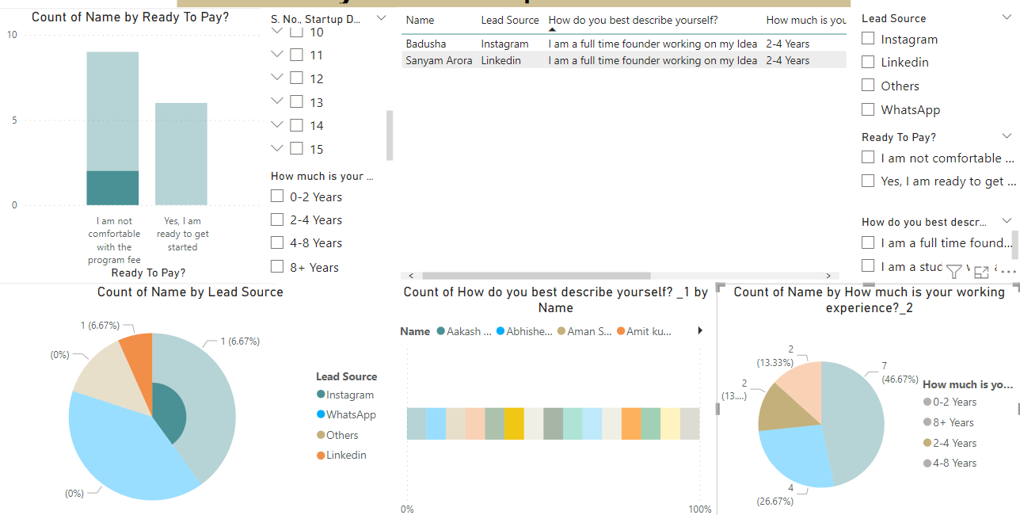
Visual Representation

Slide 29
12. Founder Name: Varun Kumar MN
Business Idea: The Local Store
Stage: Validation
Ability to Pay: High
Strengths
High market potential
Weaknesses
Inventory management complexities
Positive initial user feedback
Community-focused retail approach
High competition in the local retail space

Slide 30

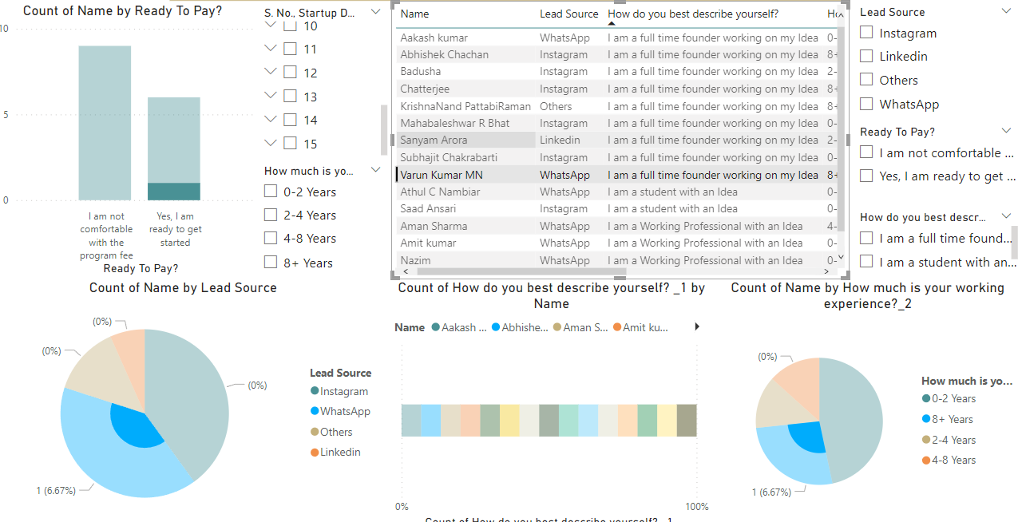
Visual Representation

Slide 31
13. Founder Name: Abhishek Chachan
Business Idea: Avasar, a digital word-of-mouth brand building platform
Stage: Validation
Ability to Pay: High
Strengths
Addresses a niche market with high potential
Weaknesses
Measuring campaign effectiveness
Positive initial user feedback
Leverages social proof for brand-building
High competition in the digital branding space

Slide 32

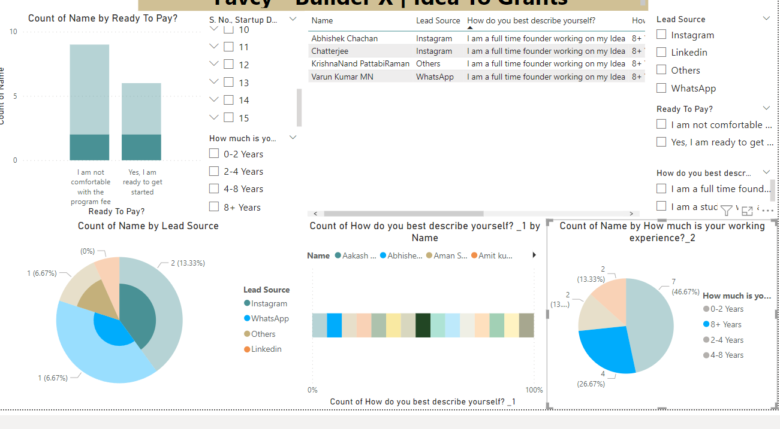
Visual Representation

Slide 33
14. Founder Name: KrishnaNand PattabiRaman
Business Idea: Retail tech platform
Stage: Validation
Ability to Pay: Low
Strengths
High market potential
Weaknesses
Integration with existing retail systems
Positive initial user feedback
Innovative retail technology solutions
High competition in the retail tech space

Slide 34

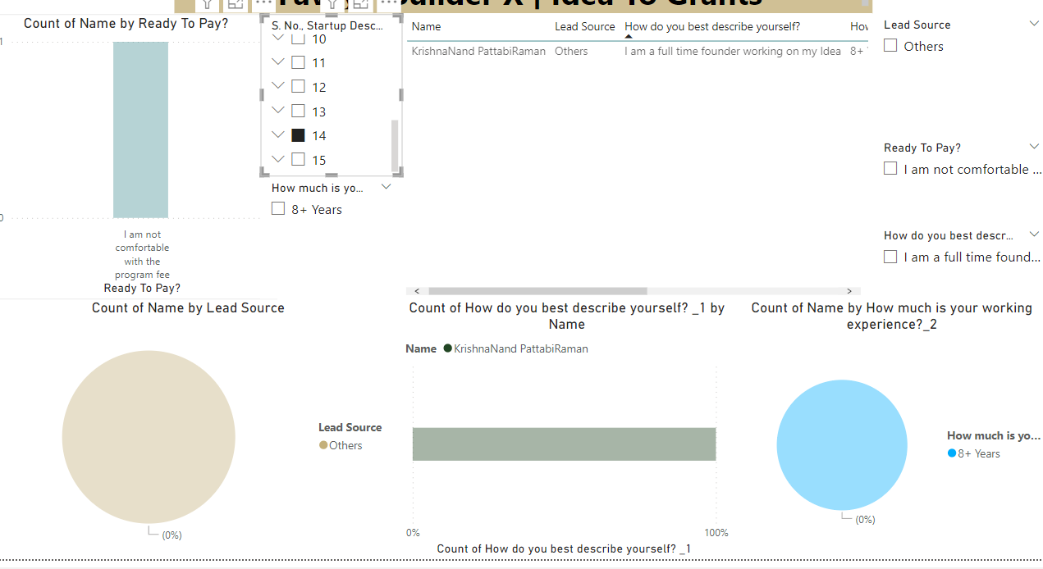
Visual Representation

Slide 35
15. Founder Name: Saad Ansari
Business Idea: Community-based startup for impactful projects (e.g., high-scale terrarium for reducing global warming)
Stage: Validation
Ability to Pay: High
Strengths
High market potential
Weaknesses
Long project timelines
Positive initial user feedback
Strong focus on environmental impact
High competition in the community-based project space

Slide 36
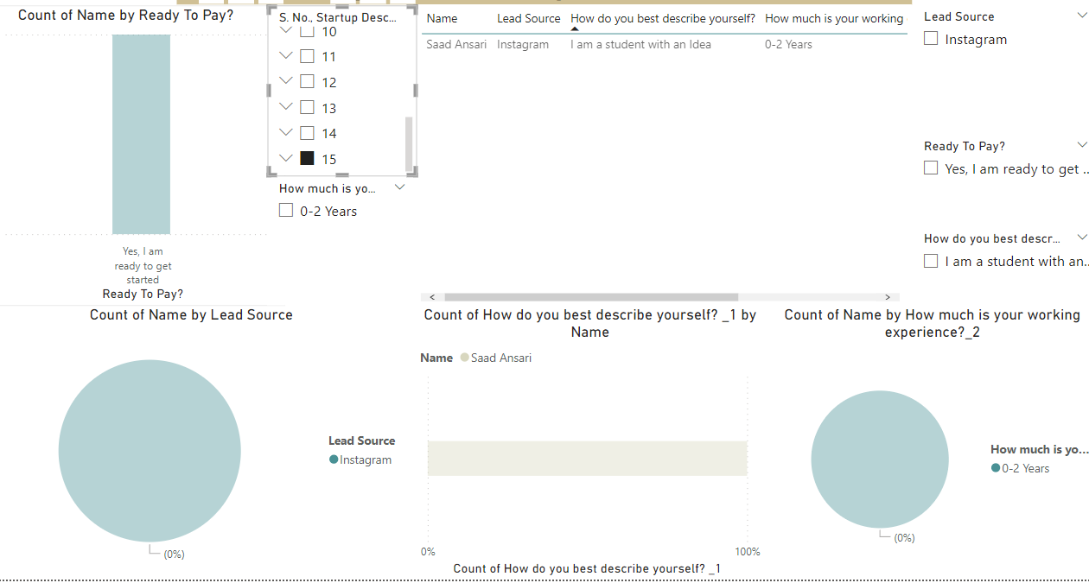
Visual Representation

Slide 37
Thank You
Subham Choudhary

